Slide 1
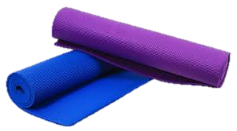
Wellness Center
Luke Yanek, Andres Hartman
and Eric Borkowicz

Slide 2
Background
1968 – 10 Varsity Teams
2014 – 22 Varsity Teams

Slide 3
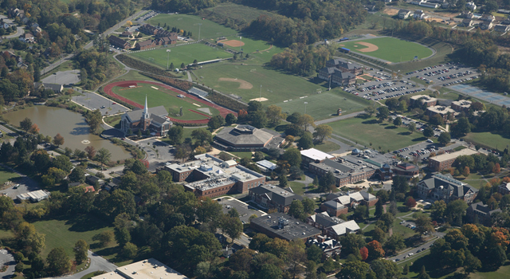
Campus Overview

Slide 4
Site Design
South of Soccer Field
Freedom of Design

Slide 5
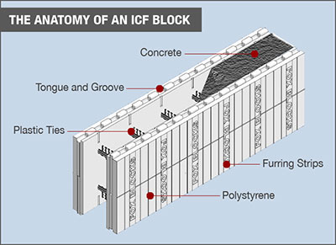
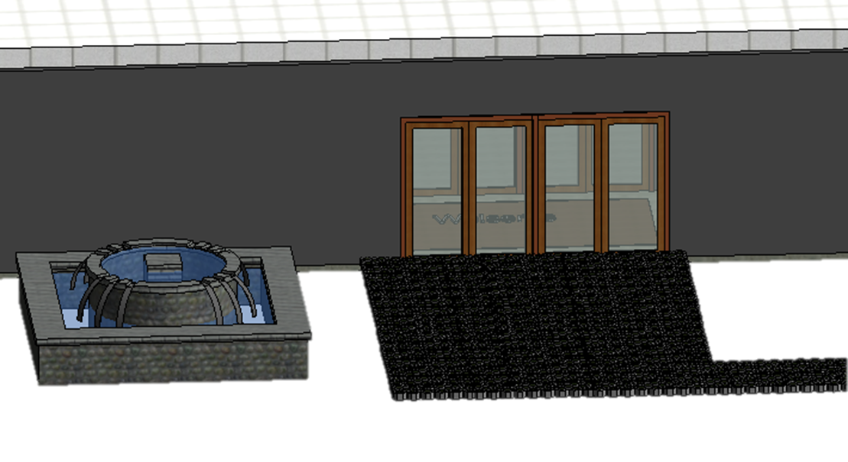
Exterior Structure
Insulated Concrete Forms
Double Doors
Permeable Pavement

Slide 6
Interior Structure

Slide 7
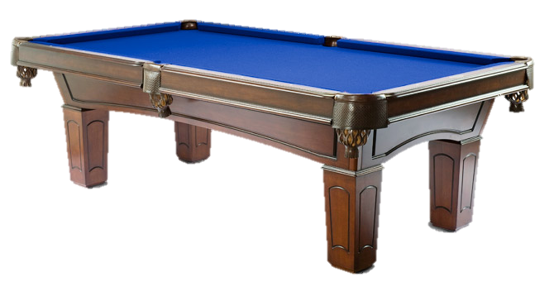
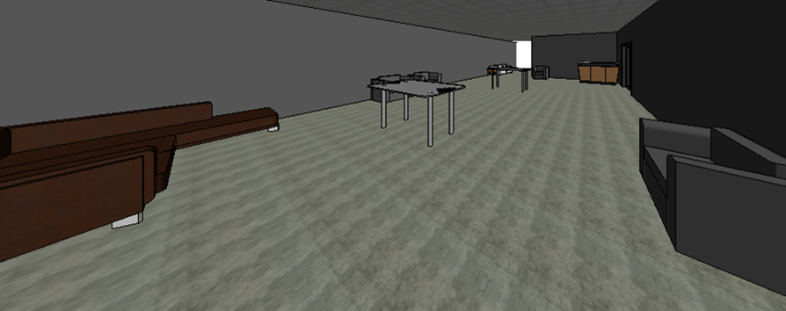
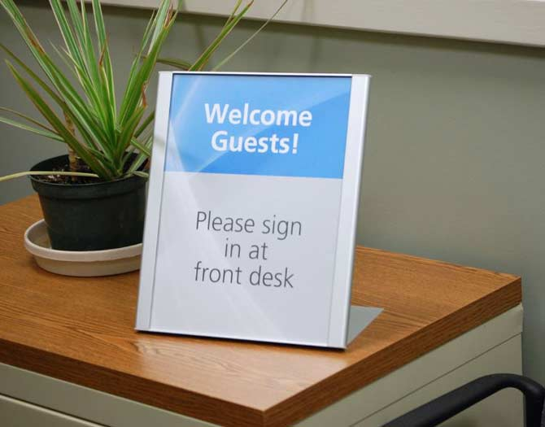
Entrance
Relaxing Area
Sign in Desk

Slide 8
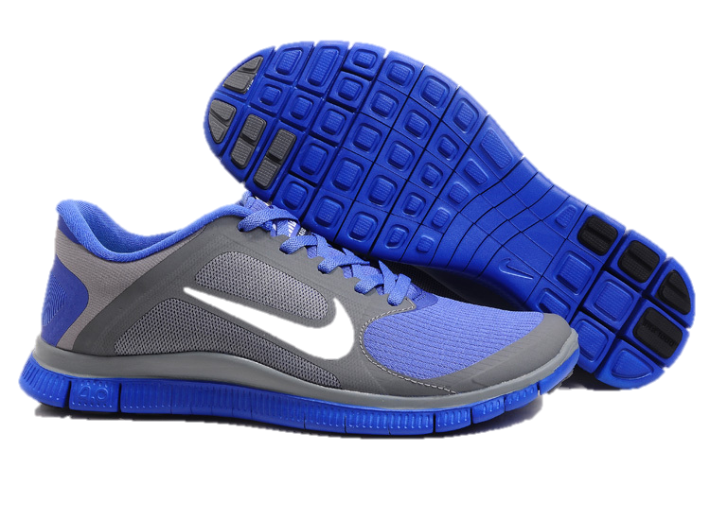
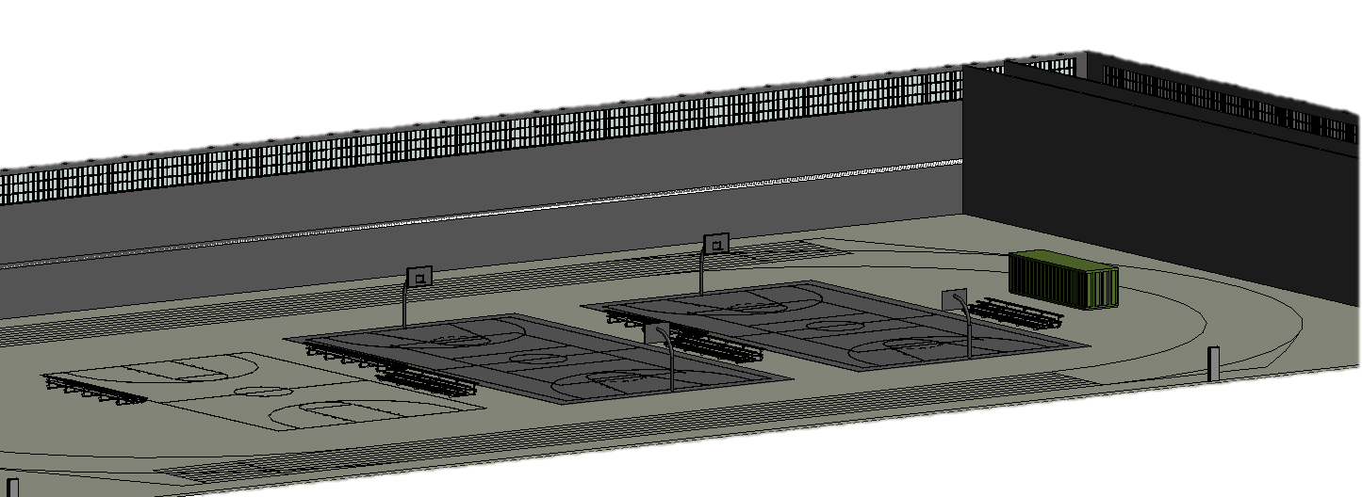
Main Gym
Full size track
2 multipurpose courts
1 wooden basketball court

Slide 9
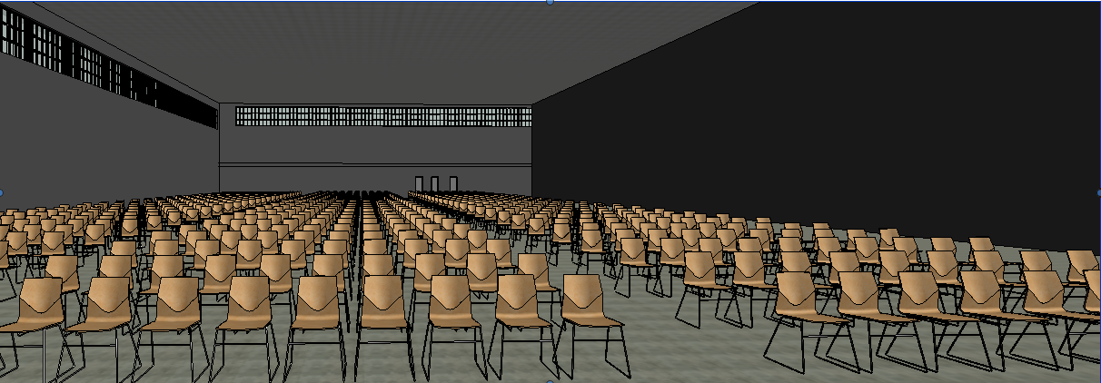
Multipurpose Space
Used for anything
Removable chairs and projector screen

Slide 10
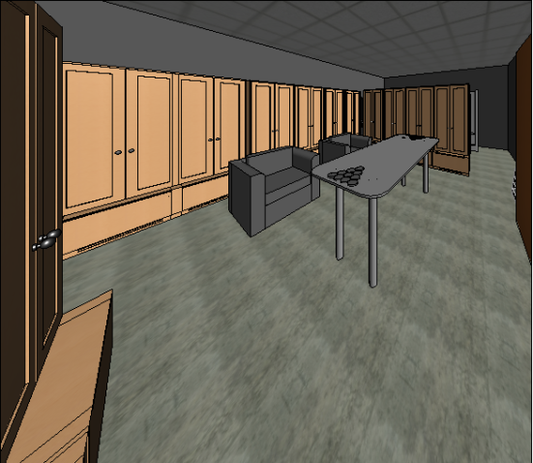
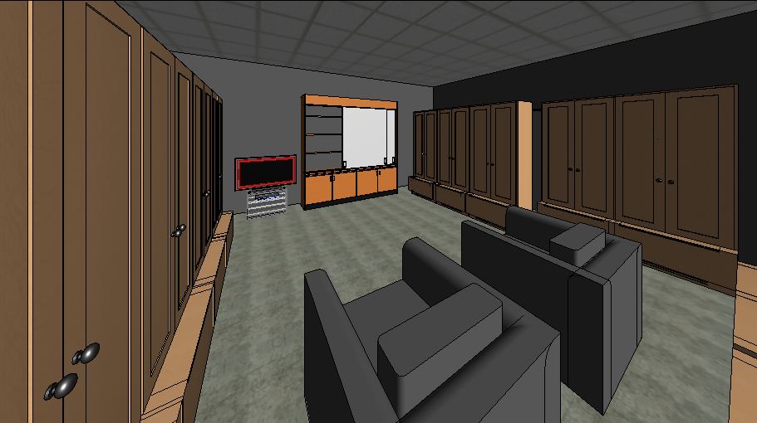
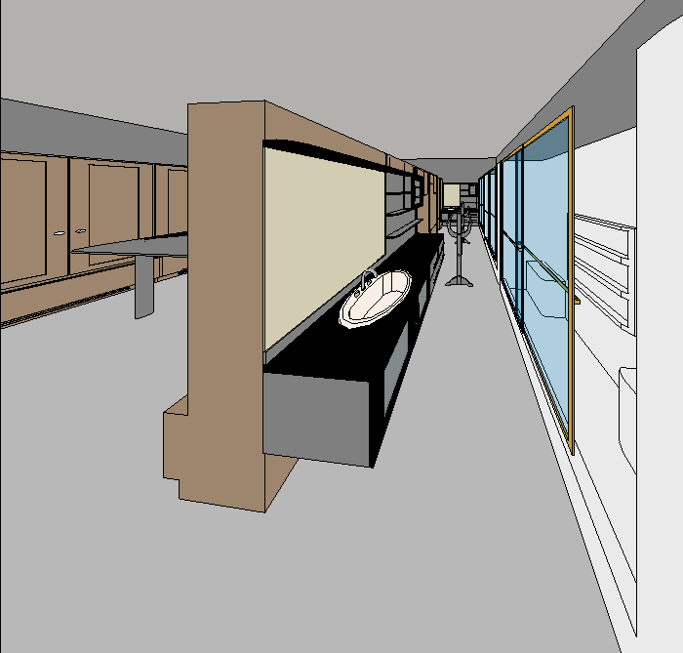
Locker Rooms
3 sizes
All with bathroom and shower

Slide 11
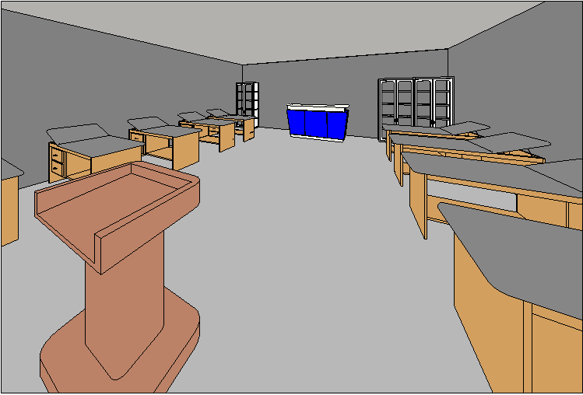
Training Room
Large Space

Slide 12
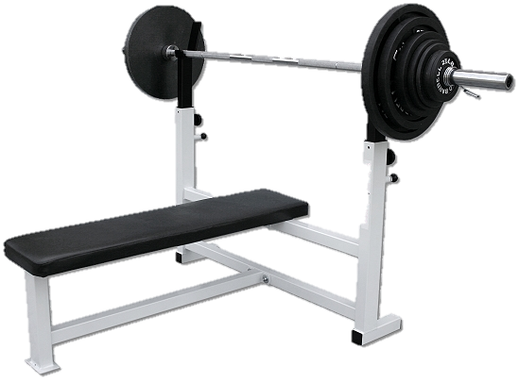
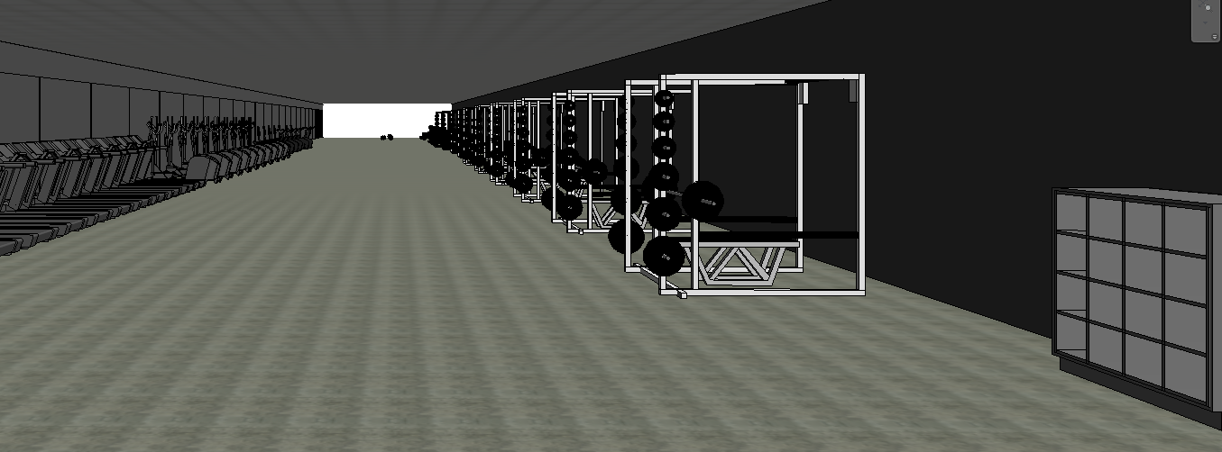
Fitness Center
Cardio and weight area
Open space for free weights + abs
Cardio faces open windows

Slide 13
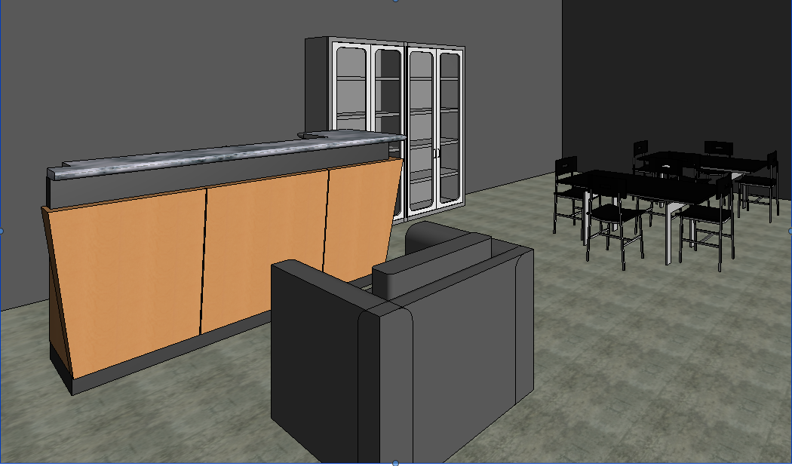
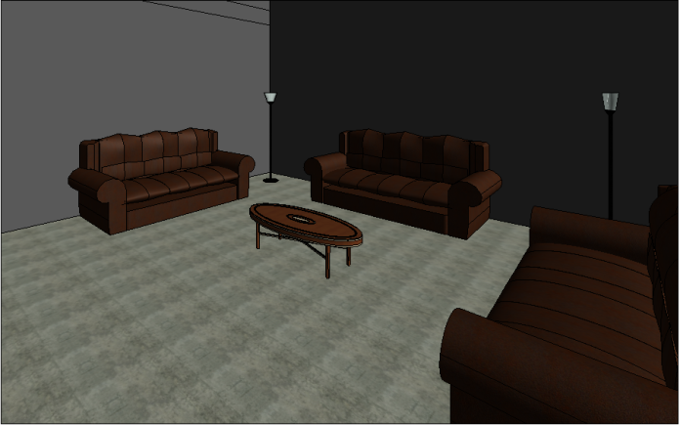
Wellness Area
Offices and personal
counseling areas
Group therapy

Slide 14
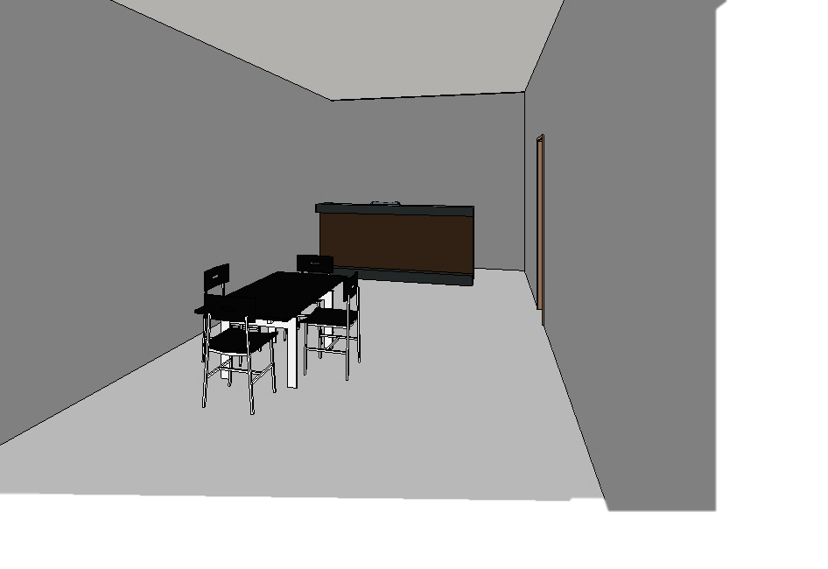
Snack Bar

Slide 15
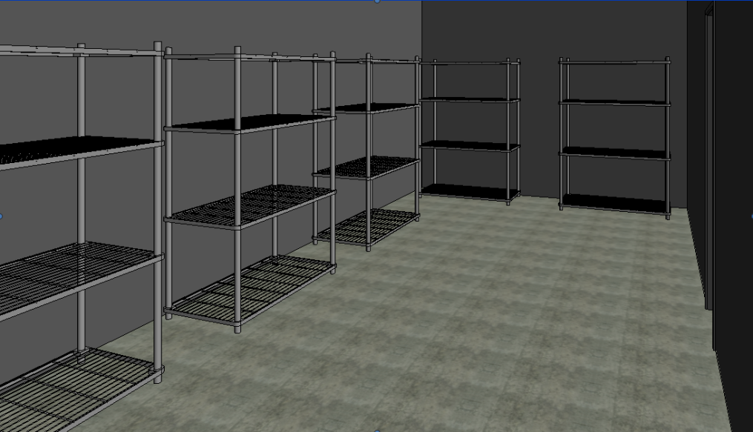
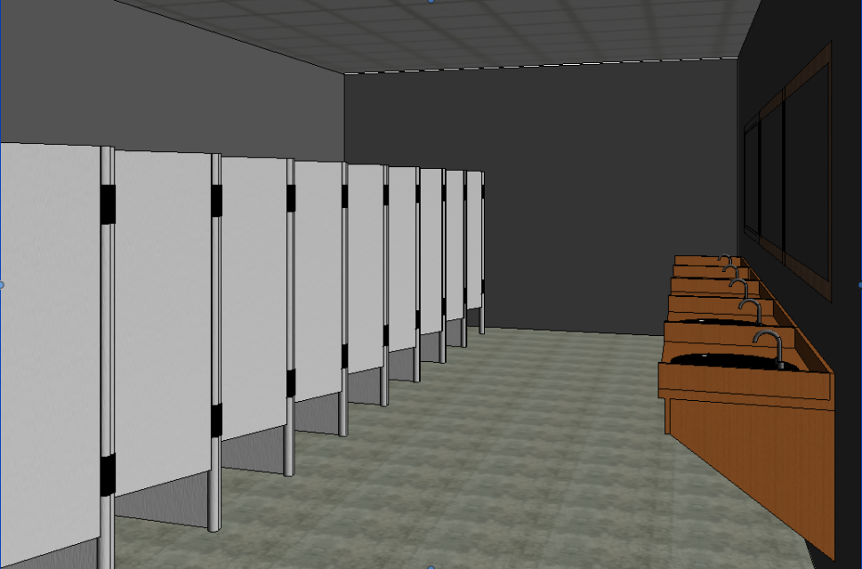
Storage and Restrooms
Storage room and
2 storage lockers
2 men’s, 2 women’s
Bigger and smaller

Slide 16
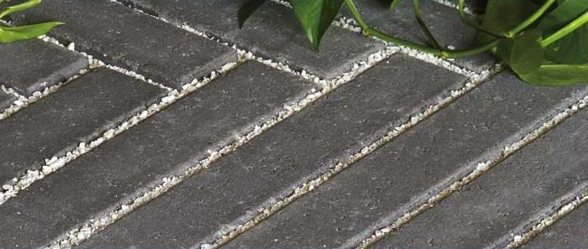
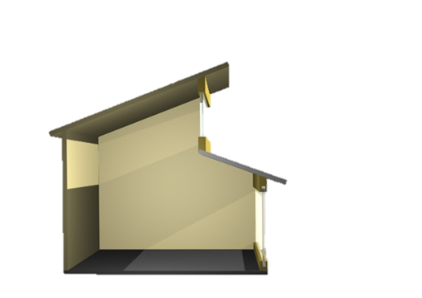
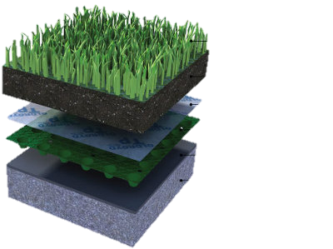
Key Design Choices
Green Roof
Permeable Pavement
1 Floor
Clear Story
Plants
Growing Medium
Filter Fleece
Drainage Layer
Waterproofing Membrane
Concrete Slab

Slide 17
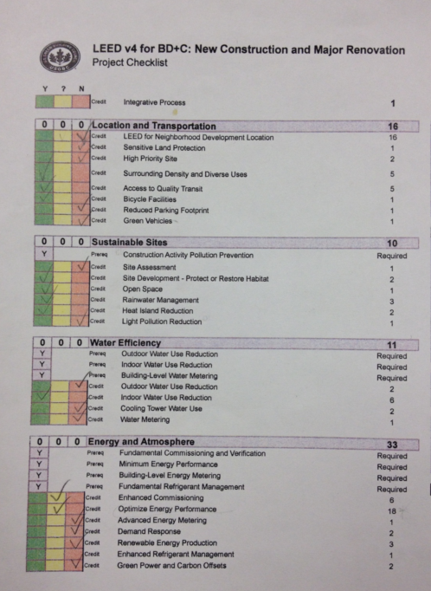
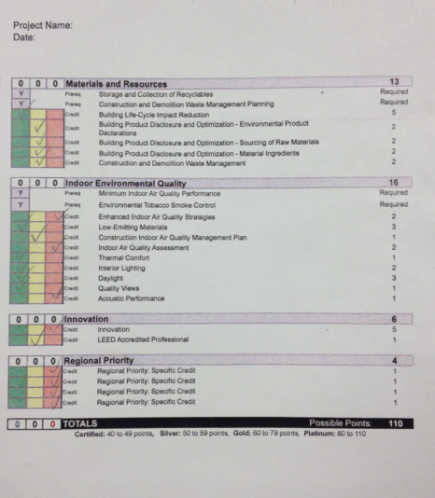
LEED Accreditation

Slide 18
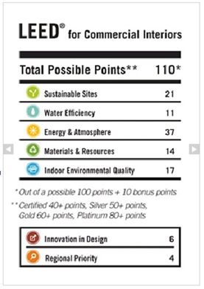
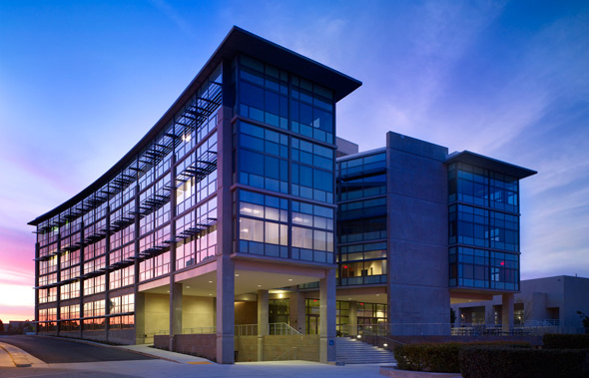
LEED Accreditation
Certified to Gold

Slide 19
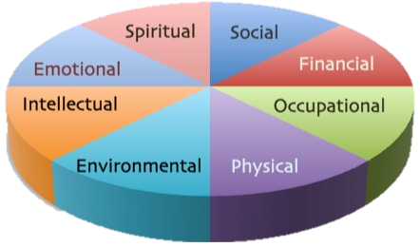
Closing Summary
Improve Elizabethtown College

